Slide 1

Quantum Neural Distinguisher for Differential Cryptanalysis
For Simplified DES
Quantum
Boogies
https://youtu.be/1MeE5NJU-Us
Quantum Boogies : 김현지, 임세진, 강예준, 김원웅

Slide 2

Contents
01
Differential Cryptanalysis
02
Quantum neural distinguisher
03
Evaluation
04
Conclusion and future work
Quantum
Boogies

Slide 3
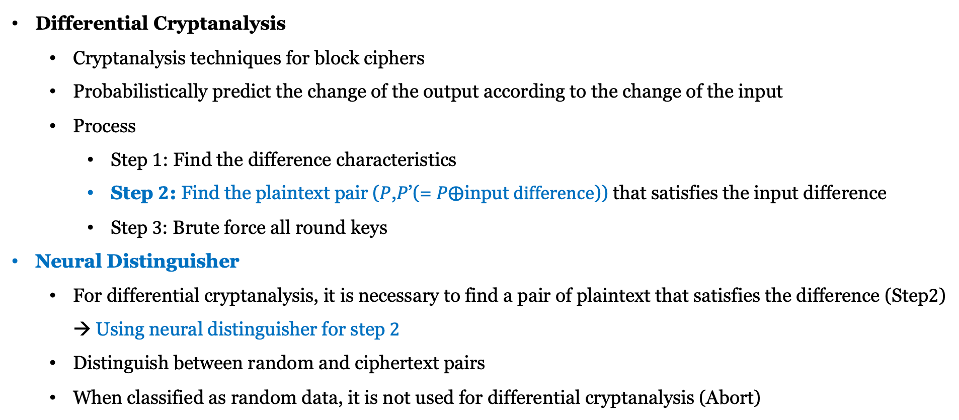
01
Differential Cryptanalysis
Differential Cryptanalysis
Cryptanalysis techniques for block ciphers
Probabilistically predict the change of the output according to the change of the input
Process
Step $1$: Find the difference characteristics
Step $2$: Find the plaintext pair (𝑃,𝑃’(= 𝑃$⨁\text{input} difference$)) that satisfies the input difference
Step$3$: Brute force all round keys
Neural Distinguisher
For differential cryptanalysis, it is necessary to find a pair of plaintext that satisfies the difference (Step$2$) → Using neural distinguisher for step $2$
Distinguish between random and ciphertext pairs
When classified as random data, it is not used for differential cryptanalysis (Abort)

Slide 4
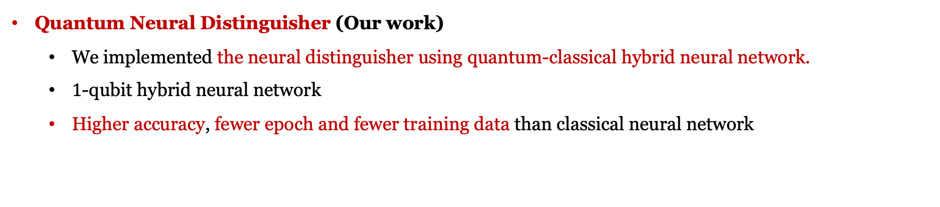
01
Differential Cryptanalysis
Quantum Neural Distinguisher (Our work)
We implemented the neural distinguisher using quantum-classical hybrid neural network.
$1$-qubit hybrid neural network
Higher accuracy, fewer epoch and fewer training data than classical neural network

Slide 5

02
Quantum neural distinguisher
Design of quantum neural distinguisher
Encryption the plaintext pairs (random and difference)
Ciphertext pairs are input to quantum-classical hybrid neural network
Classical NN → Quantum circuit (quantum layer) → Classification (Random or Cipher)
Random plaintext pairs and
differential plaintext pairs ($0$x$96$)
Plaintext pair
S-DES Encryption
Hybrid Neural Network
Binary classification
$0$ : Random
Ciphertext pair
Classical NN
Quantum Circuit
$1$: Cipher

Slide 6
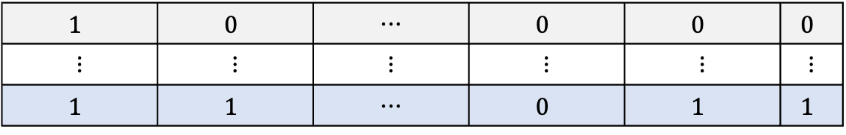
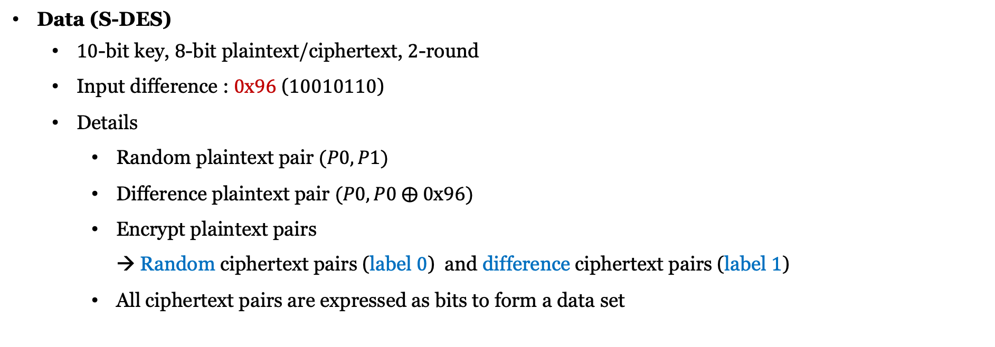


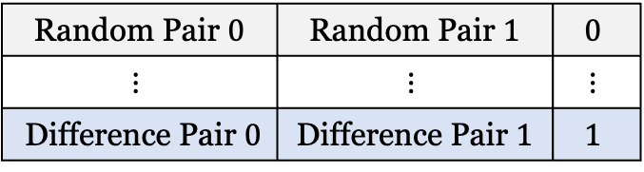
02
Quantum neural distinguisher
Data (S-DES)
$10$-bit key, $8$-bit plaintext/ciphertext, $2$-round
Input difference : $0$x$96$ ($10010110$)
Details
Random plaintext pair $(P0, P1)$
Difference plaintext pair $(P0, P0 ⨁ 0$x$96)$
Encrypt plaintext pairs → Random ciphertext pairs (label $0$) and difference ciphertext pairs (label $1$)
All ciphertext pairs are expressed as bits to form a data set
Data
Label
Random/Difference Pair $0$(Bit)
Random/Difference Pair $1$(Bit)
Label
Random Pair $0$ | Random Pair $1$ | $$0$$
$$⋮$$ | $$⋮$$ | $$⋮$$
Difference Pair $0$ | Difference Pair $1$ | $$1$$
$$1$$ | $$0$$ | ⋯ | $$0$$ | $$0$$ | $$0$$
⋮ | ⋮ | ⋮ | ⋮ | ⋮ | ⋮
$$1$$ | $$1$$ | ⋯ | $$0$$ | $$1$$ | $$1$$

Slide 7
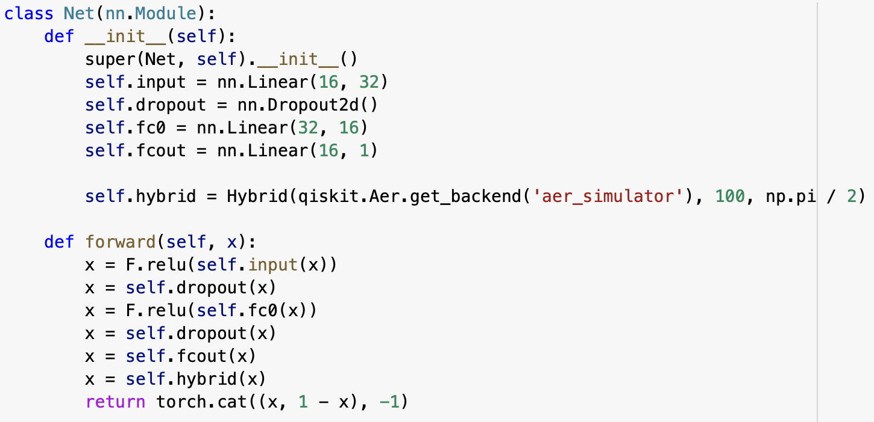
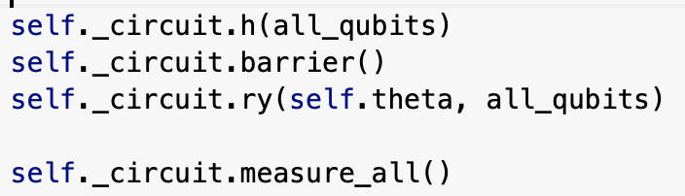
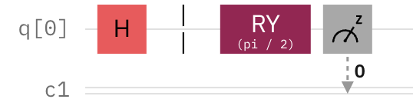
02
Quantum neural distinguisher
Quantum-classical hybrid neural network
Architecture of hybrid neural network
Architecture of quantum circuit

Slide 8
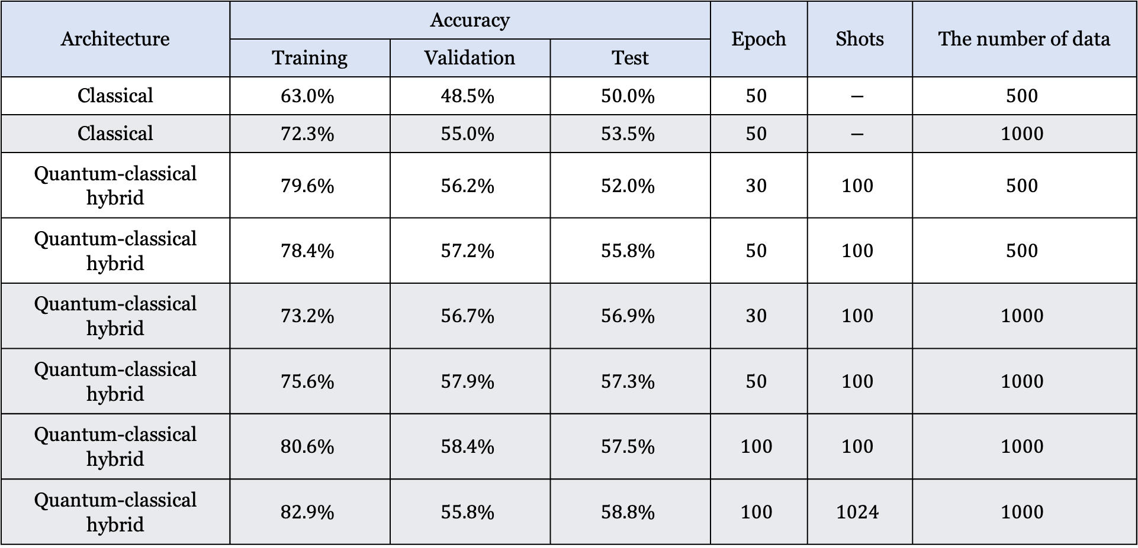
03
Classical Neural Distinguisher vs. Quantum Neural Distinguisher for S-DES
Architecture | Accuracy |  |  | Epoch | Shots | The number of data
 | Training | Validation | Test
Classical | $$63.0\%$$ | $$48.5\%$$ | $$50.0\%$$ | $$50$$ | $$−$$ | $$500$$
Classical | $$72.3\%$$ | $$55.0\%$$ | $$53.5\%$$ | $$50$$ | $$−$$ | $$1000$$
Quantum-classical hybrid | $$79.6\%$$ | $$56.2\%$$ | $$52.0\%$$ | $$30$$ | $$100$$ | $$500$$
Quantum-classical hybrid | $$78.4\%$$ | $$57.2\%$$ | $$55.8\%$$ | $$50$$ | $$100$$ | $$500$$
Quantum-classical hybrid | $$73.2\%$$ | $$56.7\%$$ | $$56.9\%$$ | $$30$$ | $$100$$ | $$1000$$
Quantum-classical hybrid | $$75.6\%$$ | $$57.9\%$$ | $$57.3\%$$ | $$50$$ | $$100$$ | $$1000$$
Quantum-classical hybrid | $$80.6\%$$ | $$58.4\%$$ | $$57.5\%$$ | $$100$$ | $$100$$ | $$1000$$
Quantum-classical hybrid | $$82.9\%$$ | $$55.8\%$$ | $$58.8\%$$ | $$100$$ | $$1024$$ | $$1000$$

Slide 9
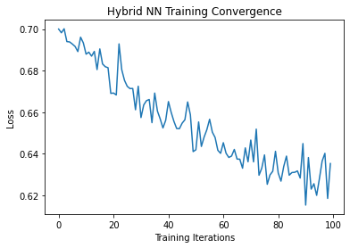
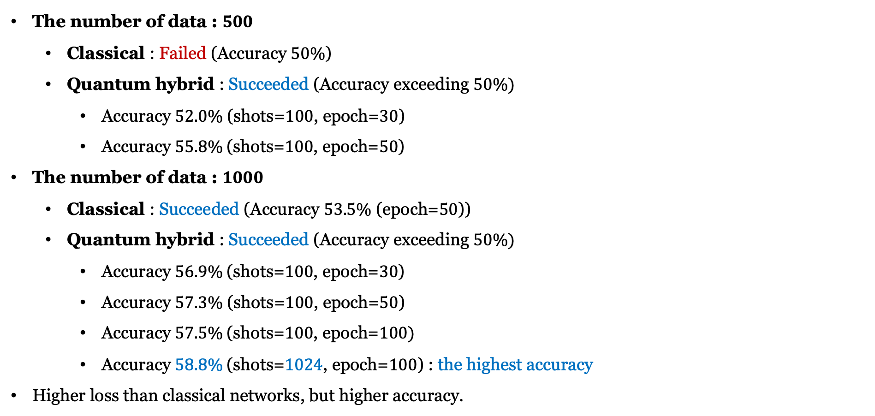
03
Discussion
The number of data : $500$
Classical : Failed (Accuracy $50\%$)
Quantum hybrid : Succeeded (Accuracy exceeding $50\%)$
Accuracy $52.0\%$ (shots=$100$, epoch=$30$)
Accuracy $55.8\%$(shots=$100$, epoch=$50$)
The number of data : $1000$
Classical : Succeeded (Accuracy $53.5\%$ (epoch=$50$))
Quantum hybrid : Succeeded (Accuracy exceeding $50\%)$
Accuracy $56.9\%$(shots=$100$, epoch=$30$)
Accuracy $57.3\%$ (shots=$100$, epoch=$50$)
Accuracy $57.5\%$(shots=$100$, epoch=$100)$
Accuracy $58.8\%$(shots=$1024$, epoch=$100$) : the highest accuracy
Higher loss than classical networks, but higher accuracy.

Slide 10
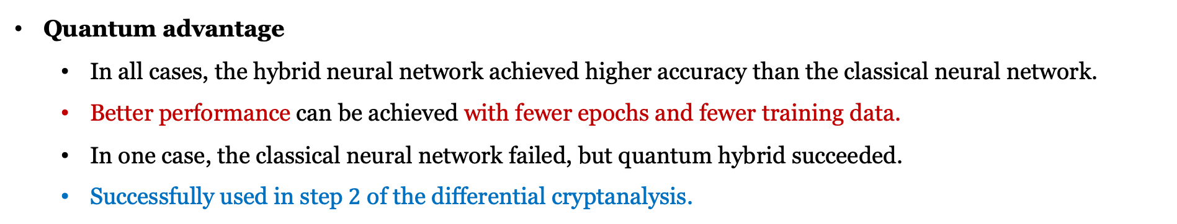
03
Discussion
Quantum advantage
In all cases, the hybrid neural network achieved higher accuracy than the classical neural network.
Better performance can be achieved with fewer epochs and fewer training data.
In one case, the classical neural network failed, but quantum hybrid succeeded.
Successfully used in step $2$ of the differential cryptanalysis.

Slide 11
04
Conclusion and future work
Conclusion
We implemented a quantum neural distinguisher using a hybrid neural network.
Comparison with a classical neural network.
Hybrid neural network has quantum advantages
Higher accuracy, fewer training data and fewer epochs
Quantum neural distinguisher can be successfully used for differential cryptanalysis for S-DES.
Future work
Try to perform cryptanalysis for other cipher (e.g. S-AES, DES, Speck).
Improving our accuracy
Apply QSVM (only quantum circuits) to a quantum distinguisher.

Slide 12
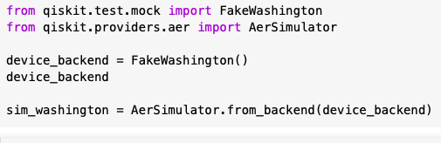
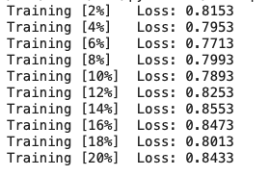
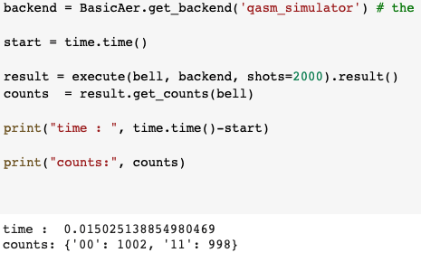
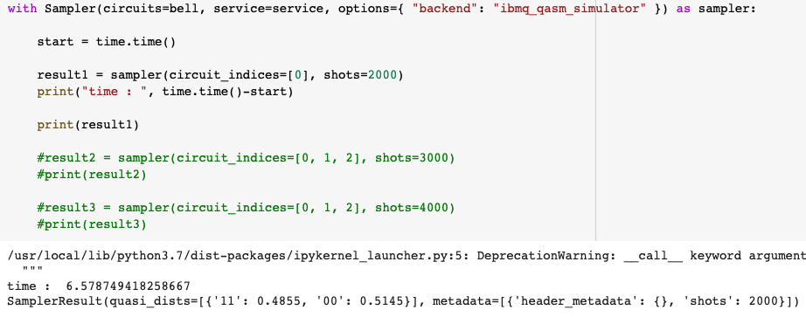
05
해커톤에서 알게 된 것
Fake device
100 큐빗 디바이스를 사용할 수는 있으나 매우 느리고 노이즈가 심함 → 원래 0.7에서 시작해서 0.6정도까지 loss가 감소 그러나 동일한 작업 시에도 0.8에서 감소하지 않다가 10%정도 학습했을 때부터 loss 증가
Qiskit runtime
더 빠르다고 했는데 동일한 회로로 실험했을 때 더 느림..
Qiskit 메모리는 8GB이상 쓸 수 없어서 로컬 사용 권장
Colab에 Qiskit 설치 후 실행했더니 더 빠름
원래 1시간 이상 걸리던 작업이 20분 정도면 가능

Slide 13

Thank you for your attention.
Quantum
Boogies

